Slide 1
Introduction to Web Programming
Jiayi “Joey” CaO
jcao7@Illinois.edu

Slide 2
There are 5 major stages:
Stage 1: Functional Description & Entity-Relationship Design
Requirements:
Pitch/short description (Every group is required to meet us during our office hours)
Usefulness and existing analogs
Is it really useful to our society?
Realness
How do you plan to get data? Users?
Features
Basic functionality
Advanced functionality
ER diagram- with all necessary assumptions

Slide 3
There are 5 major stages:
Advanced features for the project
Should be relevant and useful for your application
No primary analogs accessible just via API
Should be technically challenging (machine learning, data viz with serious preprocessing, real-time)
at least 3-4 days of work for the whole team per advanced function to implement excluding learning how to code
build upon external libraries not just use them as-is
You should be able to clearly explain the technical challenge in each advanced function

Slide 4
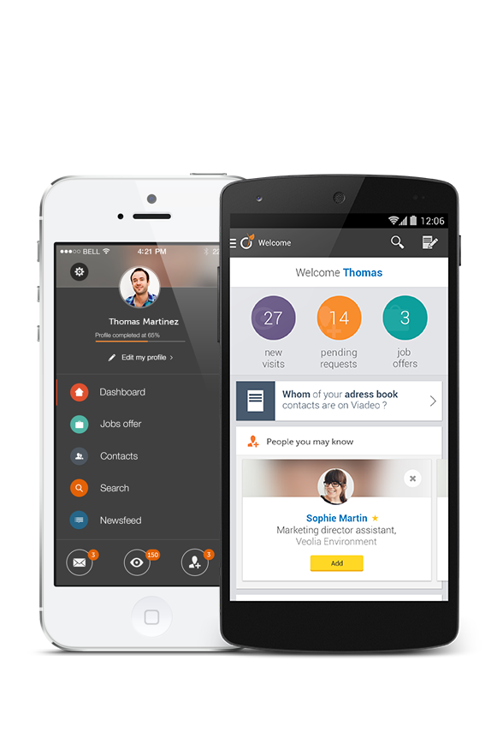
There are 5 major stages:
We will build iOS and Android mobile apps…

Slide 5

A mobile app itself doesn’t count
There are 5 major stages:

Slide 6
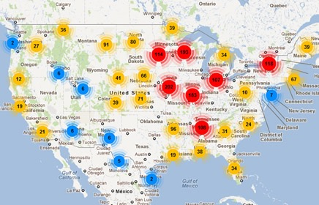
There are 5 major stages:
We will have a cool map with interactive clickable elements…

Slide 7
There are 5 major stages:
Using Google API doesn’t count

Slide 8

We will extract data from IMDB…
There are 5 major stages:

Slide 9
We will extract data from IMDB…
There are 5 major stages:

Slide 10

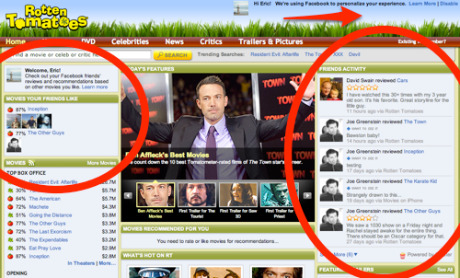
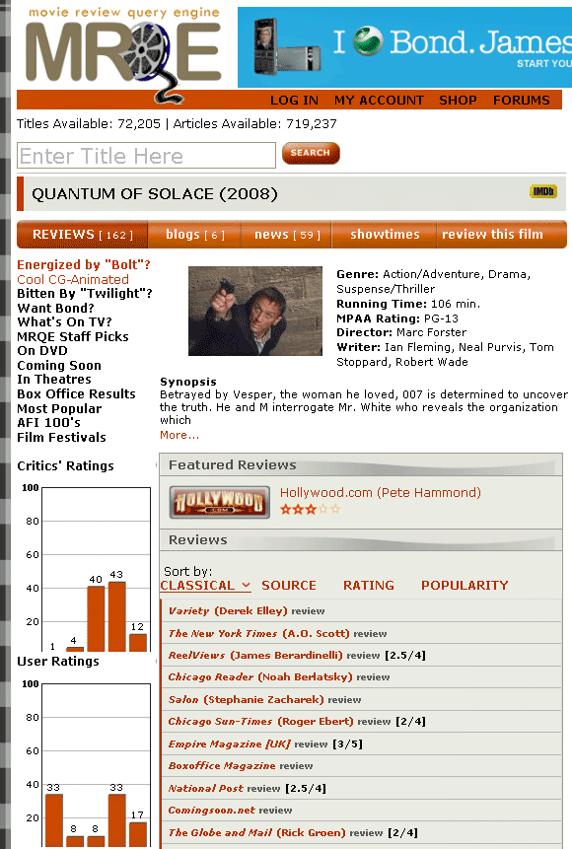
We will extract data from 100 movie websites automatically…
There are 5 major stages:

Slide 11

We will extract data from 100 movie websites automatically…
There are 5 major stages:

Slide 12
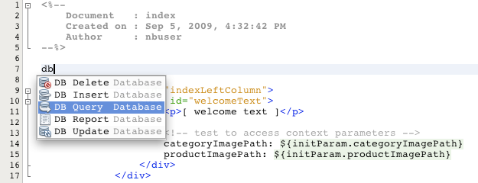
We will do SQL query suggestion based on DB schema…
There are 5 major stages:

Slide 13
We will do SQL query suggestion based on DB schema…
There are 5 major stages:

Slide 14
There are 5 major stages:
Rules of thumb to help you judge whether it qualifies for AF
A good data-driven company released a similar feature a few years ago
You can make a startup out of it because building such a thing is hard
There is a research paper at a top conference talking about it but no one in the industry built it yet – you can take make a demo illustrating a research idea (can write a paper about it)
Discuss with your TAs ;)

Slide 15
There are 5 major stages:
Stage 2: Development Plan
The relational schema of your database
Final choices of databases and software platforms/languages that you will be using
How you will get data for your application (crawling the Web/API/crowdsourcing…)
Division of responsibilities of team members
The project timeline with milestones

Slide 16
There are 5 major stages:
Stage 3: Setup Development Environment
Play with cPanel, MySQL, HTML
Initiate a site and add your project URL to Wiki
the site could be empty but the URL must be working (just put there name of team members for now)
If you are building a mobile app, assemble a project package and share it via a quick release (link to the app download and early access)

Slide 17
There are 5 major stages:
Stage 4: Midterm Demo (10 min)
Data enough to showcase CRUD functionality
Working basic functionality
Create/Insert records to the DB
Read/Search records in the DB
Update records in the DB
Delete records from the DB
Advanced SQL queries(subquery, having, case, union, etc)
Remember:- This shouldn’t be your login information
Describe your advanced functions and clearly articulate why they are advanced

Slide 18
There are 5 major stages:
Stage 5: Final Demo (15-20 min)
Final Demo including
Real data in the system (crawled from the Web, using API, or from user’s generated data having at least 25 + records)
Record a project demo video
Repeat CRUD/basic functionality
Join queries
Present your advanced functions and clearly articulate why they are advanced
Project Final Report

Slide 19
There are 5 major stages:
DB Project 1 Grading
[4%] Stage 1: Functional Description
[3%] Stage 2: Development Plan
[3%] Stage 3: Setup Development Environment
[30%] Stage 4: Initial Demo [25%] + 2 SQL queries [5%]
[60%] Stage 5: Final Demo + Report + Video
[40%] Final Demo
[10%] Basic features and joins
[30%] Advanced features
[15%] Final Report
[5%] Demo video (2-3 min video on Youtube)

Slide 20
What is Web Programming?
Usually refers to the non-design aspects of building a website:
Writing markup and coding
It ranges from creation of a simple static html page to the most complex web-based application or social network service

Slide 21
Why Web Programming for CS411 Database System?
One of main choices of building applications around a Database Management System(DBMS)
User access point for retrieving and utilizing data stored in database
Cross platform application

Slide 22


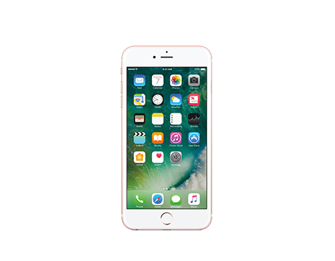
Server Side
How does web-based application work?
Client Side

Slide 23

Two Parties in Web Development
Client Side
Requests content from the server side
Responsible for displaying the data to user
Lightweight computation
Server Side
Serves data according to client side’s request
Responsible for storing and retrieving data, authentication and computations.
Heavyweight computation

Slide 24

An example of website workflow
User opens browser and enteres website URL
Browser sends a request to the Server
Server sends response(client code)
Browser receives client code
Browser starts rendering page according to client code
Request additional data if necessary
Loop: Exchange of requests and response according to user’s interaction

Slide 25
Client Side Technology
Web Application
Mobile Application
Usually presents in Web browsers
Typical written in HTML, CSS, JavaScript
Permissions are set by the browser
Popular platforms are iOS and Android
iOS apps written in Objective-C or Swift
Android apps written in Java or JavaScript
Permissions are controlled by phone’s
permission manager

Slide 26
Client Side Programming
HTML
Describe the content of the page
“What does it have?”
CSS
Describe the presentation of the page
“How does it look?”
JavaScript
Describe the interaction of the page
“What does it do?”

Slide 27
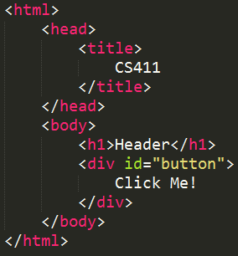
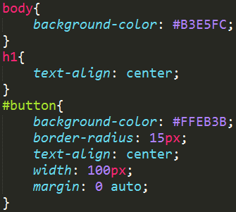
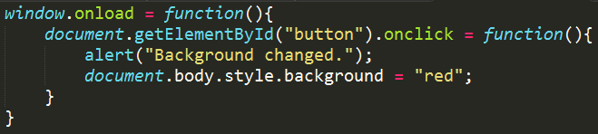
HTML
CSS
Javascript

Slide 28
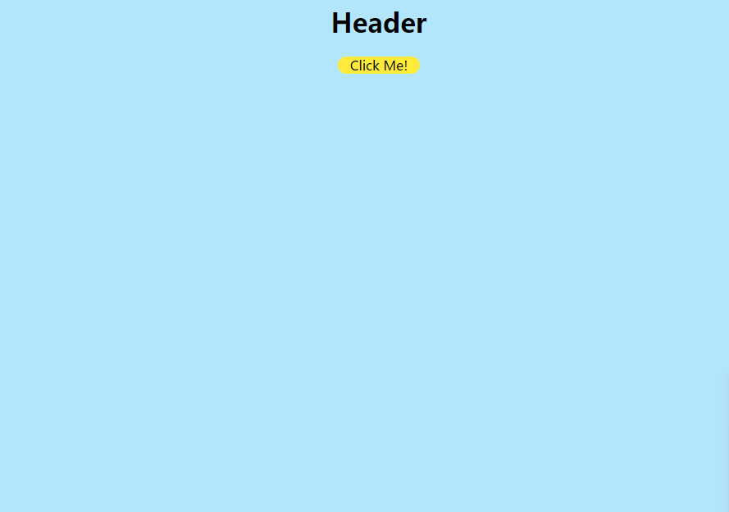
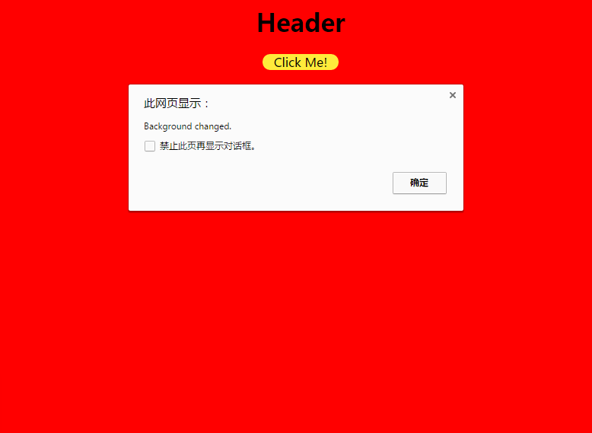

HTML + CSS
HTML + CSS + JavaScript
HTML Only

Slide 29
HTML – HyperText Markup Language
Describes and defines content of a webpage
Hierarchical Structure
Various tags as cues for the appearance of content
Outmost tag is always <html>
<head> tag contains page metadata:
(information about the page)
<body> tag contains the main content

Slide 30
More HTML tags
<a href=“URL to cotent”></a> - Hyperlink
<img src=“URL to image”/> - Image
<p></p> - Paragraph
<br /> - Line Break
<div></div> - Division for organizing tags
<table> - Table, <tr> for row <td> for column
<tr><td></td><td></td></tr>
</table>

Slide 31
CSS – Cascading Style Sheets
Describes and defines presentation and style of a webpage
Can describe styles using 3 types of selectors:
A certain type of tags
Element with certain ID or Class
Elements with certain ordering relative to others
Basic syntax is
Selector {
Attribute: Attribute Value;
Attribute2: Attribute Value2;
….
}

Slide 32
JavaScript
An interpreted language used to describe the behavior of the webpage
Allow users to interact with the webpage or add dynamic content to the page
Read HTML data
Editing content(texts and images) and styles
Send asynchronous requests
React to events such as mouse click, mouse move and window loaded, etc.
Lightweight computation such as validating form data

Slide 33
JavaScript
Dynamically typed variables: No need to declare type.
var name = “Joey”;
name = 123;
Use element = document.getElementById(“ElementID”) to retrieve html elements
Use element.style.[attribute] to change styles
Use element.innerHTML to change content
Similar control flow syntax to Java or C++

Slide 34





Frontend Development in Practice
Developers usually use frameworks to alleviate pain from writing repeated code, unreasonable syntax, and unclear program structure. Some of the popular frontend frameworks are:
Bootstrap
Foundation
Materialize
MaterialUI
SemanticUI

Slide 35
Server Side Technology
For data storage and computationally heavy jobs
Code runs on servers instead of user’s computer
Server Software:
Ex: Apache, Nginx
Web Programming Language:
Ex: PHP, Java, Python, Ruby
Database:
Ex: MySQL, PostgreSQL, SQLite

Slide 36
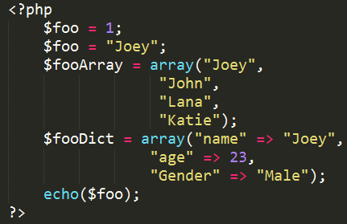
PHP
Designed for web scripting
All variables starts with “$”
Variables are dynamically typed
Many native functions to interact with the webpage
Starts with <? php
Ends with ?>

Slide 37
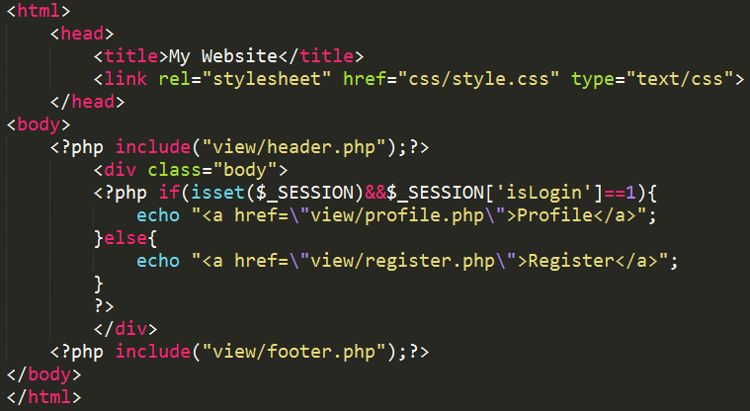
An Example Page

Slide 38
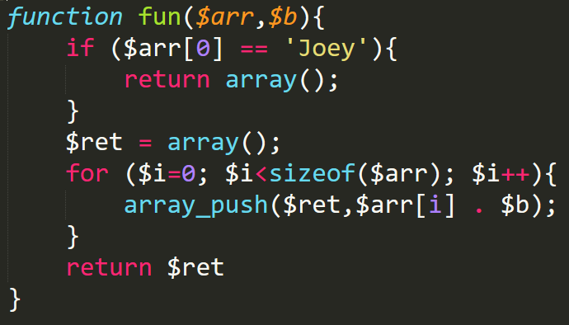
PHP
$_SESSION[‘key’] use key-value pair to store user information on server
Useful for user log-in log-out functionality
echo can render html code to webpage

Slide 39
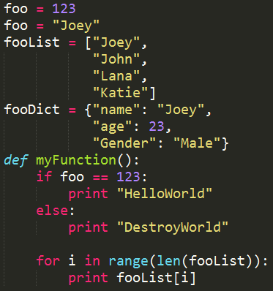
Python
Not designed specifically for web programming, therefore requires frameworks to do web programming.
Popular frameworks:
Django
Flask
Pyramid
Many native functions to interact with the webpage

Slide 40
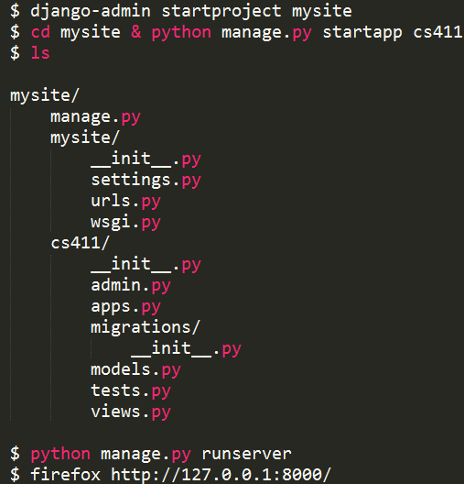
Python with Django(Setup)

Slide 41



Communication between Frontend and Backend
echo “Joey”
GET or POST request
Template parameter

Slide 42
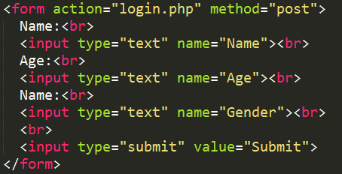
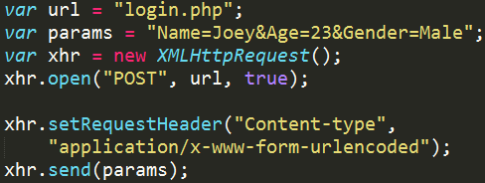
Frontend to Backend
Through HTML form
Through JavaScript

Slide 43
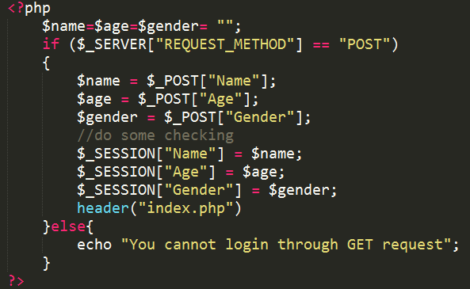
PHP receive data and render page

Slide 44
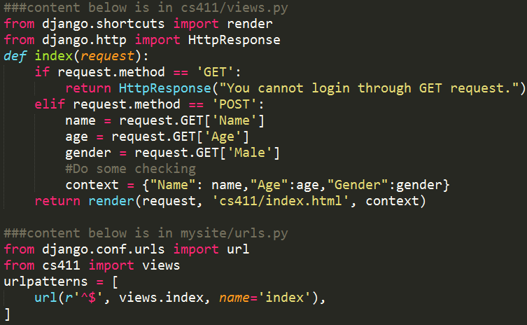
Django receive data and render page

Slide 45
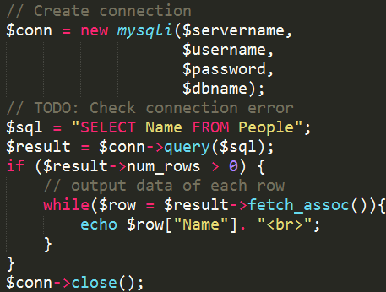
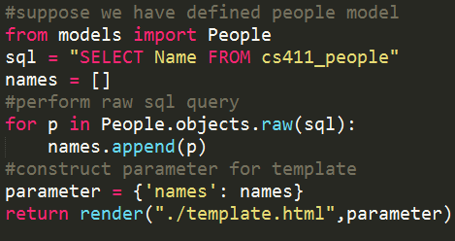
Talk to Database
PHP
Python

Slide 46
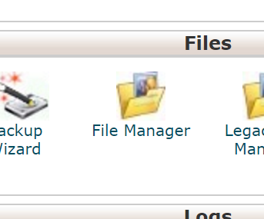
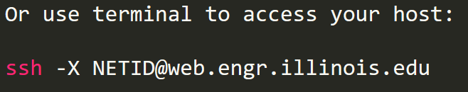
Try PHP in cPanel
If you have cPanel configured, Sign in with you netid in the below link:
https://web.engr.illinois.edu
Go to the File Manager
Select Web root and then click Go
Select new file
Type in some simple PHP command using the code editor
Save it as trial.php in public_html folder
Go and check at
http://netid.web.engr.illinois.edu/trial.php

Slide 47
Request a shared CPanel Account
Use this link to get access to cPanel:
http://my.engr.illinois.edu/getcpanel
Only one team member can request the space and add the
other members information
To see what frameworks and Service are available:
https://documentation.cpanel.net/display/ALD/cPanel%20User%20Documentation
If you have any problems: Contact engrit-help@illinois.edu

Slide 48
Final Tip: Start Early
Need to learn a lot of technologies
Research more to decide what tools to use
Environment setup

Slide 49
Questions?

